Slide 1
Topic 14
Timing Issues

Slide 2
Outline
Timing requirements for FSM
Setup time and hold time
Asynchronous input and metastability
Synchronizer
Switch debouncing
Clock skew
Hazards

Slide 3
State Machine
Finite State Machine
Next State
(NS)
Inputs
FSM Outputs
Combinational
Logic
State
Register
Present
State (PS)
Outputs
Feedback of
present state

Slide 4
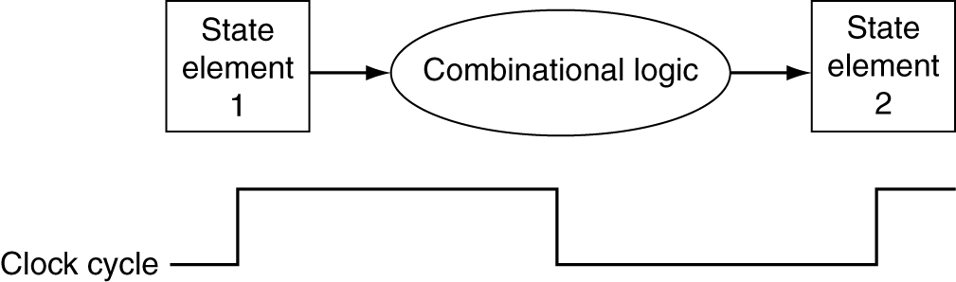
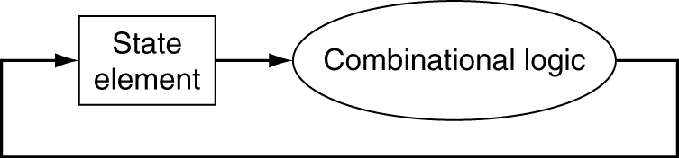
Clocking Methodology for FSM
Combinational logic transforms data during clock cycles
Between clock edges
Clock cycles should be
Long enough to allow combinational logic completes computation
Longest delay determines clock period
Short enough to ensure acceptable performance and to capture small changes on external inputs

Slide 5
Hardware Constraints – Setup and Hold
An edge-triggered flip-flop will not operate correctly if the data is not stable for a sufficient time before and after the clock edge
Storage element may be put in nondeterministic state
Setup Time
Minimum time that data must be stable prior to the triggering edge
Setup-time violations are cause by combinational paths that are long relative to the clock cycle
Fix: stretch clock, optimize combinational circuit, split combinational circuit, pipelining,
Clock
Setup Time

Slide 6
Hardware Constraints – Setup and Hold
Hold Time:
Minimum time that data must remain stable after the triggering edge
Hold-time violations are caused by short paths that allow a signal to propagate from a source flip-flop to a destination flip-flop and change the data that was created in the previous cycle before the destination flip-flop has registered its output
Fix: insert buffers, use different flip flop
Setup and hold time: ns
Clock
Hold interval

Slide 7
Metastability and Asynchronous Inputs
If the setup or hold time of an edge-triggered flip-flop is violated the flip-flop may enter a metastable state.
Metastable state: Any flip-flop state other than stable 1 or 0
Eventually settles to one or other, but we don’t know which
For internal circuits, we can make sure setup time is satisfied
But what if input comes from external (asynchronous) source, e.g., button press?
State_m
Metastable state
State_0
State_1

Slide 8
Metastable State
Assuming D = 0 → 1 while rising edge of clock (0 → 1)
May oscillate and never stops if D and clock changes at exactly same time
In reality, DFF will settle eventually after some time (hopefully within a clock cycle)
1
P3
2
P1
5
Q
D
Q
Clock
Clock
Q’
P2
6
Q’
3
4
P4
D

Slide 9
Asynchronous Inputs
In a fully synchronous system, all circuits are driven by a common clock, and the state registers may change only under the control of the clock
Synchronous system may be driven by asynchronous inputs which may put flip flops into the metastable state
Examples: Keyboard activity, push buttons, and interrupts to a computer.
Problems caused by asynchronous inputs
The unpredictable arrival of an asynchronous input may cause a setup condition to be violated.
Glitches on the asynchronous inputs may cause system failure.
Asynchronous fanout path delays might cause some input transitions to be "caught " by some devices and "missed" by others.
General rule: Ensure that all inputs are synchronous, i.e. synchronize them to the clock signal. Reset and set can be exceptions.

Slide 10
Synchronizer
Use a D-type flip flop to synchronize the input.
Synchronizer
Synchronized input
Asynchronous
D
Q
Input
Synchronous
system
Clk
clock

Slide 11
Synchronizer Failure
The systems input is synchronized, but the setup and hold conditions of the synchronizing flip-flop may be violated.
The synchronizing flip-flop may enter a metastable state and disrupt system operation.
The flip-flop may be in metastable state, then its state will be nondeterministic, its output may be interpreted as
“0”, or
“1”, or
enter a metastable state, output is not synchronized anymore
A circuit that uses the output of a synchronizer that is in the metastable state is said to experience a synchronizer failure.
To recover from a synchronizer failure
wait for the circuit to leave the metastable state, the time is unpredictable, or
execute a reset to put the system into a known state.

Slide 12
Double DFF Synchronizer
Reduce the possibility of synchronizer failure
Use flip-flops having the shortest possible setup and hold intervals
stretch the clock period to allow more time for the circuit to recover
Output final settles in 0 or 1
But means slower circuit
Insert double-synchronizing D-type flip-flops after the asynchronous inputs
Inputs
D
Q
D
Q
Synchronous
FF_1
FF_2
system
Clk
Clk
clock

Slide 13
Double DFF Synchronizer
Both flip-flop must enter a metastable state to have a synchronizer failure
The first flip-flop might enter a metastable state, but has a clock period to recover
It is less likely that FF_2 will see an input that is not valid, thus it is less likely that FF_2 will enter a metastable state
Typically, 1 clock cycle is long enough for 1st DFF to recover
Output of 2nd DFF is synchronized and stable, but unpredictable
Synchronizer
Synchronized input
Asynchronous
D
Q
D
Q
Input
Synchronous
FF_1
FF_2
system
Clk
Clk
clock

Slide 14
Synchronizer with More FFs
More FFs is unnecessary
However, synchronizer failure can never be 100% avoided
We can just maximize the Mean Time Between Failures (MTBF) -- a number often given along with a circuit
very
very
very
incredibly
l
o
w
low
low
l
o
w
ai
synchronizers

Slide 15
Bouncing Switch
Asynchronous input to a synchronous logic circuit may be created by a mechanical switch or a push button (mechanical component)
When changing from one position to another, the switch may bounce away from the contact point
V
DD
Data
analog
Data
Data
Digitized version

Slide 16
Switch Debouncing
Debouncing circuit: SR latch
When throw is at position 0,
S = 1, R = 0, Data = 0
When throw changes to position 1
R = 1, S = (0 1), Data = 1
Data is latched regardless of S
assuming switch won’t bounce
back to position 0 and touch it
V
DD
r1
S
1
Data
0
S R Q Q⁺ 0 0 0 X 0 0 1 X 0 1 0 1 0 1 1 1 1 0 0 0 1 0 1 0 1 1 0 0 1 1 1 1
R
not allowed
r2
set
reset
V
DD
hold

Slide 17
Switch Debouncing
D Flip Flop may be used
for switch debouncing
But clock needs careful design
D
Clock_L
Data_L
Clock_S
Data_S

Slide 18
Switch Debouncing
The clock signal triggering the D flip flop should be slow enough to allow the switch to settle
The clock should be fast enough to allow the asynchronous input to take effect as soon as possible
Bouncing time: ms
The D flip flop may be replaced by
a double DFF synchronizer
thus both synchronizing and
debouncing will be taken care of
by one circuit

Slide 19
Clock Skew
Example: add synchronous control to a D flip flop
Choice 1: control the input by mux
Choice 2: gated clock
Gated clock is not a good practice
Flip flops that have gated clock will observe the clock change later than flip flops that have direct clock;
The situation in which the clock signal arrives at different flip flops at different times is known as clock skew
Clock skew may cause
synchronous circuit behaves
asynchronously
Ld
0
D
Q
Q
Data
1
Clock
Q
Data
D
Q
Clock
Q
Ld

Slide 20
Clock Skew
Clock skew should be minimized as much as possible
H-Tree: carefully designed distribution network try to create the same length from each flip flop to the clock source
If same length may not be achieved, buffers are inserted on the short paths to even the delay
Same for the global asynchronous reset

Slide 21
Glitches and Static Hazards
The output of a combinational circuit may make a transition even
though the patterns applied at its inputs do not imply a change.
These unwanted transitions are called glitches.
A circuit in which a glitch may occur is said to have a hazard.
static 1-hazard
static 0-hazard
1-Hazard
0-Hazard

Slide 22
Static Hazards
Static hazards are caused by different propagation delays on the
reconvergent fanout paths
Example: F = AC + BC'
Initial inputs: A = 1, B = 1, C = 1 and F = 1
New inputs: A = 1, B = 1, C = 0 and F = 1
With non-zero propagation delays, the path to F1 will be longer than the path to F0, causing a change in C to reach F1 later than it reaches F0.

Slide 23
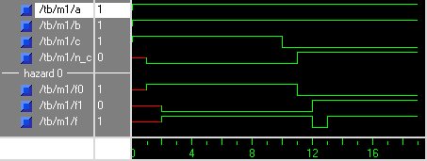
Static Hazards Example

Slide 24
Static Hazards
C
Hazards might not be significant in a
synchronous sequential circuit if the
clock period can be stretched
A hazard is problematic in an
asynchronous circuit (including Mealy FSM)
If transition is within the same group
in the K-map, hazard won’t occur
will occur when transition from one
group to another
Hazard Removal
A static hazard can be removed by
using a redundant PI
AB
0
1
00
0
0
F = AC + BC'
01
1
0
11
1
1
10
0
1
C
AB
0
1
00
0
0
01
1
0
Redundant
cube
11
1
1
10
0
1
F = AC + BC’ + AB

Slide 25
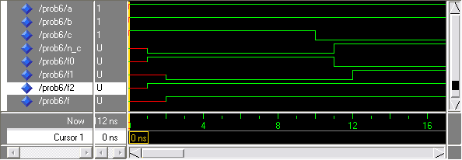
Static Hazards Example
Static 1-Hazard-Free circuit

Slide 26
Static Hazards
Static 0 hazard might not be removed in a static 1 hazard free circuit
To eliminate static 0 hazard:
method 1: cover the adjacent 0s in the corresponding POS expression
method 2: first eliminate the static 1 hazards. Then verify in the K-map if 0 hazards have been eliminated already
cd
Cover by
cd
ab
00
01
11
10
adding a'b to
ab
00
01
11
10
Cover by
00
1
1
0
0
eliminate
00
1
1
0
0
adding (a + b')
a'c'
m0
m1
m3
m2
static-1 hazard
m0
m1
m3
m2
01
1
1
1
1
01
1
1
1
1
to eliminate
m4
m5
m7
m6
m4
m5
m7
m6
static-0 hazard
11
0
0
1
1
bc
11
0
0
1
1
m12
m13
m15
m14
m12
m13
m15
m14
10
0
0
0
0
10
0
0
0
0
m8
m9
m11
m10
m8
m9
m11
m10
Eliminating static 1 hazard
F = a'c' + bc + a'b
Eliminating static 0 hazard
F = (a' + c) (b + c') (a' + b)
= a'c' + bc + a'b

Slide 27
Dynamic Hazards
Dynamic Hazard: output changes more than once as a result of a single output change
Dynamic hazards are a consequence of multiple static hazards caused by multiple reconvergent paths in a multi-level circuit.
Hazard Removal:
Elimination of all static hazards eliminates dynamic hazards.
Dynamic Hazard

Slide 28
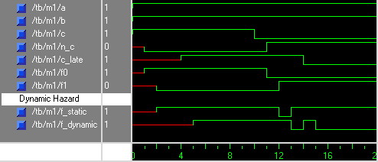
Dynamic Hazards Example
F0
First
A
reconvergence
C
F_static has a static hazard
F_dynamic has a dynamic hazard
F_static
F_dynamic
C_late
B
F1
Second
reconvergence

Slide 29
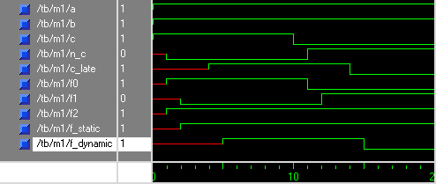
Dynamic Hazards Example
C
AB
0
1
00
0
0
Redundant group
Eliminates both
1-hazard and
0-hazard
01
1
0
11
1
1
10
0
1

Slide 30
Functional Hazard
Solutions to both static hazard and dynamic hazard are based on the assumption that only one input is changing at a time
When more than one input changes occur at the same time, the hazard caused is more complicated to remove
Example:
0 → 1
0 → 0 → 1
0 → 1
1 → 0 → 1
1 → 0
1 → 0 → 0
1 → 0

Slide 31
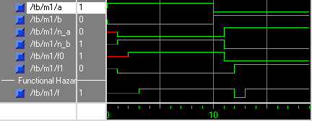
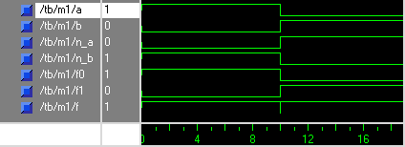
Functional Hazard
Simulation with delay
Simulation without delay. Many sim tools show this to warn for functional hazard

Slide 32
Functional Hazard
Functional hazards are unsolvable hazards which occur when more than one input variable changes at the same time
Hazards such as functional hazards can not be logically eliminated as the problem lies with actual specification of the circuit
K-map view of the functional hazard
B
 | 0 | 1
0 | 0 | 1
1 | 1 | 0
A

